Slide 1

In-House Hockey Learn to Play Program
The City of Garfield Heights Youth Hockey would like to introduce you to the game of Hockey and the Sport of Ice Skating. We have the most affordable fees in North East Ohio, easily accessible and centrally located off of I-480. We would love to see your child begin their love of the ice and advance through our program and then to a youth hockey program of their choice in Northeast Ohio. The USA Hockey model is to grow the game through Diversity, Equality, and Inclusion. This program is designed for those who want to learn the fundamentals of hockey without making a full season commitment, purchasing full equipment, or traveling and added expenses. The following skills will be taught on a regular basis:
Stick handling, puck control, passing, shooting and skating skills.

Slide 2

Not sure if this is for your child or if they will like hockey or ice skating?
Join us on one of the following “Try Before You Buy” sessions at no charge before registering for session 1 or session 2 in the Fall.
Saturday, September 21st from 10:00 am – 11:15 am for Session 1
or
Wednesday, October 30th from 6:45 pm – 8:00 pm for Session 2
Child must wear bicycle helmet, gloves and socks – rental skates will be provided. Parent or Legal guardian must accompany child and sign waiver before taking the ice for these sessions. No special walk-ons, try-outs, or pro-rating a session will be allowed during a session once it has started, we highly recommend you take advantage of these free trial sessions.
This Photo by Unknown Author is licensed under CC BY-NC

Slide 3
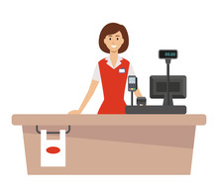
Registration Fees
Fees for 6 week session:
Residents - $100.00 + annual $20.00 Recreation ID Card
Non-Residents - $150.00 + annual $50.00 Recreation ID Card
Recreation ID is an annual fee and must be purchased at initial sign up good for the season.
An administrative late fee of $15.00 will be applied after the registration deadline date.
Equipment can be provided and rented if needed for a refundable cash deposit fee of $100.00 see office staff and hockey coordinator for details.
Birth Certificates are required for all new registrations at the time of registration, Residents need to bring in 2 forms or proof – current utility bills, bank statement or pay stub.

Slide 4
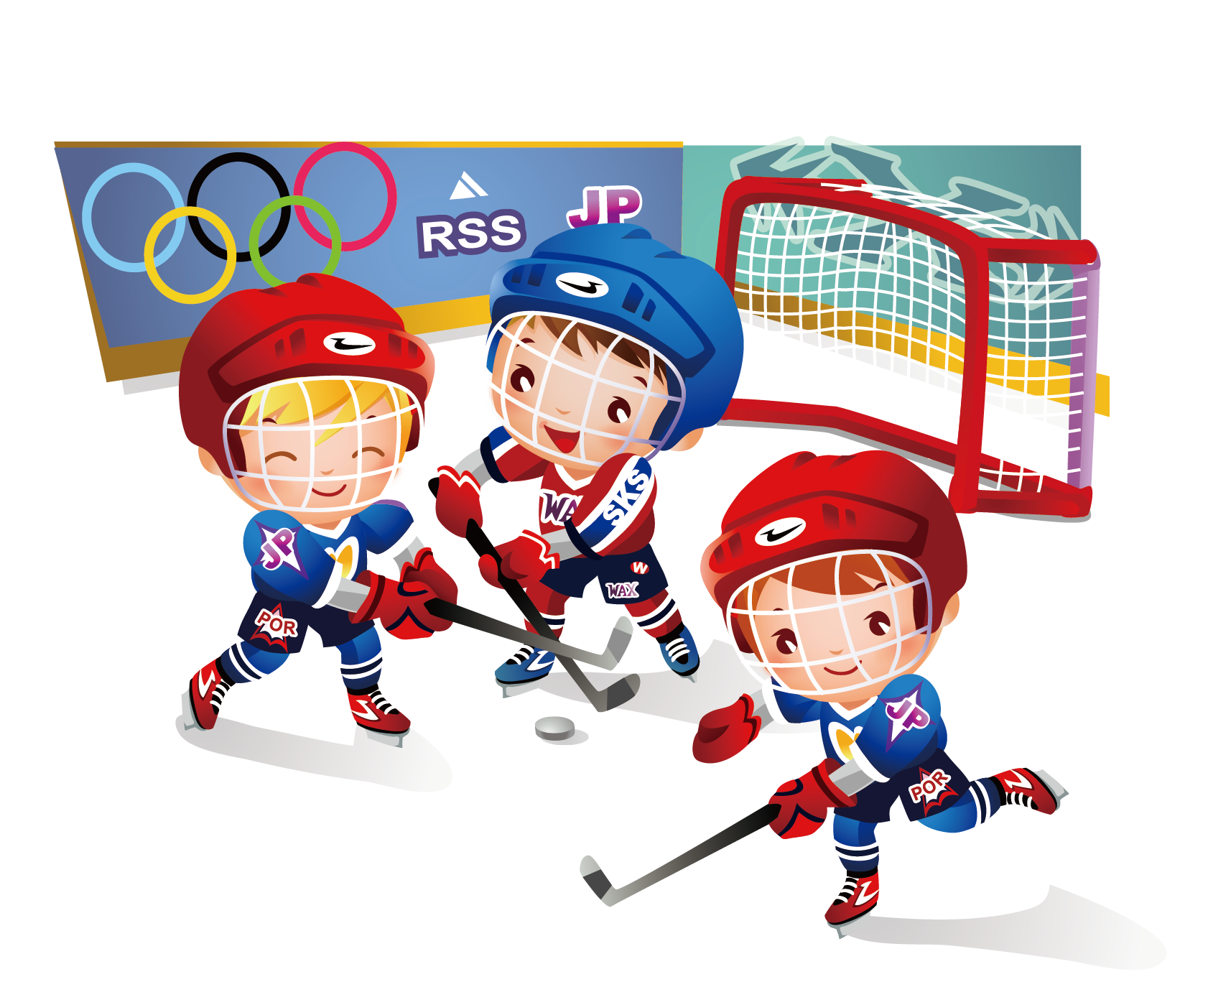
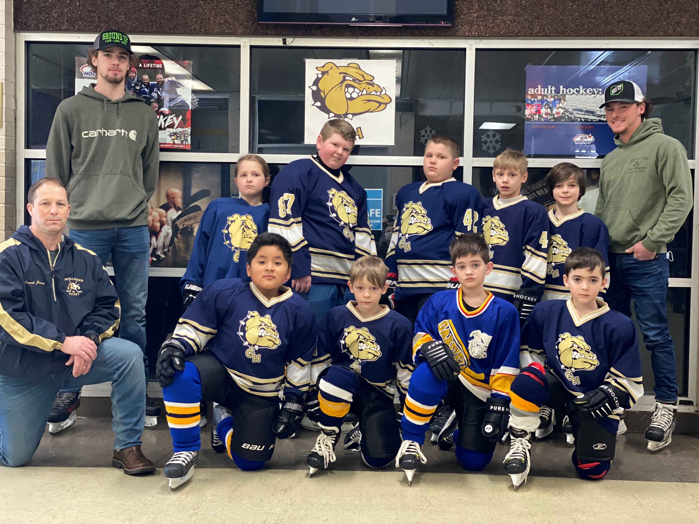
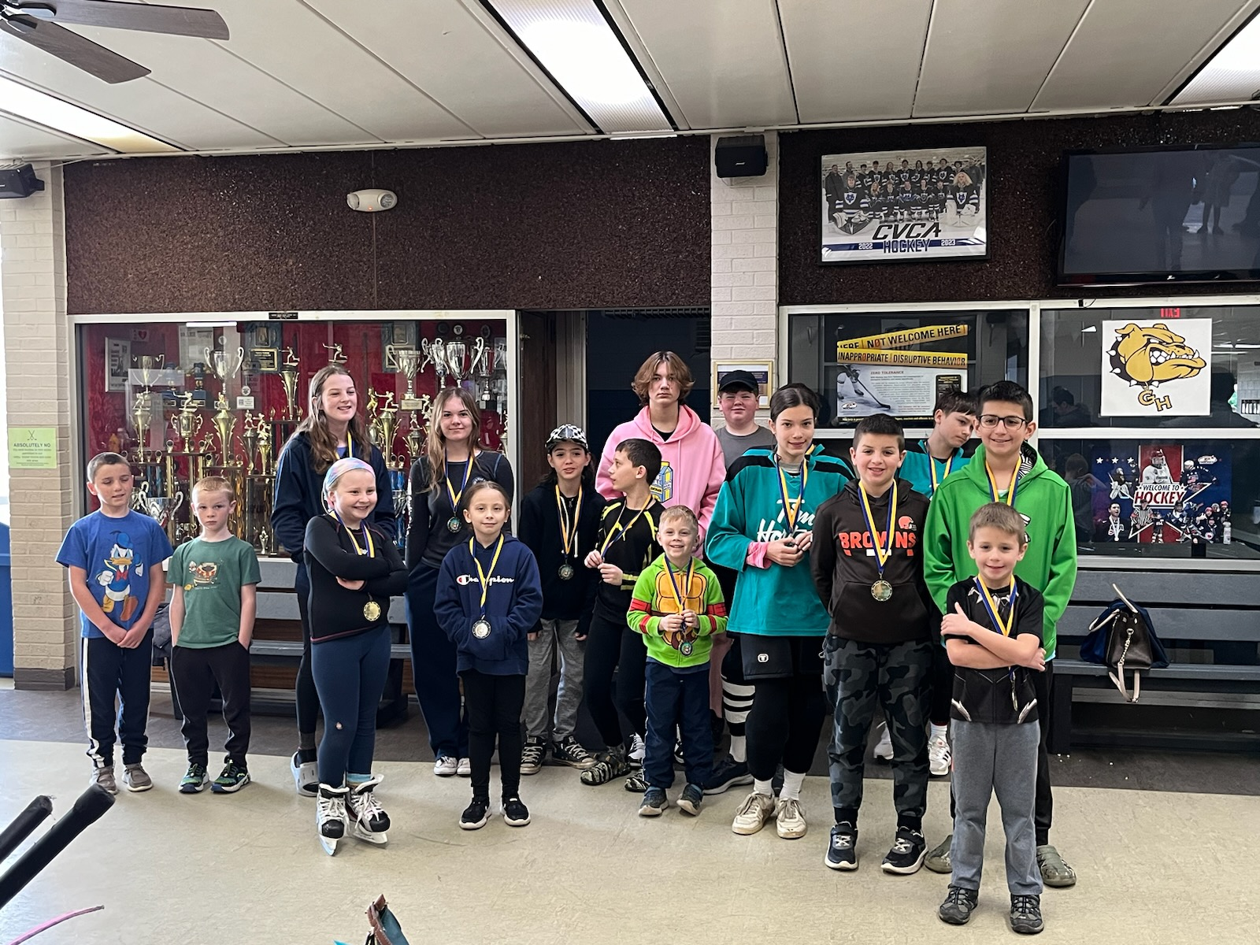
Fall Sessions
Saturdays – 9:00 am – 10:00 am
Session 1 – September 28, Oct. 5, 12, 19, 26, Nov. 2 (deadline Sept. 21st)
Session 2 – Nov. 9, 16, 23, Dec. 7, 14, 21 (deadline Nov. 2nd)
Sign up at
The Dan Kostel Recreation Center
5411 Turney Road, Garfield Heights, Ohio
Jim DiRosa, Hockey Coordinator
Sign up for text reminders during the season - text:@ghhockey to: 81010
We will send reminder messages of important dates, rec center closures/cancellations make up sessions and Stick & Puck Sessions throughout the season.
216-475-7272
2022-2023
2023-2024

